Slide 1




NEXT GEN EMPLOYABILITY PROGRAM
Creating a future-ready workforce
Team Members
College Name
Student Name : A.S.Abinayaasri
Student ID : au814721104002
SRM TRP ENGINEERING COLLEGE

Slide 2

CAPSTONE PROJECT SHOWCASE
Project Title
Notes Sharing Web Application using Django Framework
Abstract | Problem Statement | Project Overview | Proposed Solution | Technology Used | Modelling & Results | Conclusion

Slide 3
Abstract
Note-taking is a fundamental activity for students, professionals, and individuals across various domains. With the increasing reliance on digital platforms, there arises a need for a versatile, user-friendly, and collaborative note-taking web application. E-notes fills this gap by providing a feature-rich platform designed to enhance the note-taking experience.
Users can create, edit, and share notes with collaborators in real-time, facilitating seamless teamwork and knowledge sharing.
Source :

Slide 4
Problem Statement
In traditional classroom settings, students often rely on handwritten notes or individual digital documents to capture lecture content and study materials. However, these methods present various challenges that hinder the learning process and collaboration among students.so design a web application on
Title: Enhancing Classroom Learning with an Interactive Notes Web Application
Source :

Slide 5
Project Overview
The Notes Web Application project aims to create a user-friendly, versatile, and collaborative platform for digital note-taking. This web application will address the limitations of traditional note-taking methods by offering advanced features such as real-time collaboration, robust organization tools, and seamless accessibility across multiple devices.
Ensure seamless accessibility and synchronization across devices, allowing users to access and update their notes from anywhere with an internet connection.
Incorporate advanced security measures to protect user data and ensure privacy and confidentiality
Source :

Slide 6
Proposed Solution
Proposed Solution: Collaborative Notes Sharing Web Application
.
Proposed Technology Stack:
Frontend: HTML5, CSS3, JavaScript (React.js or Vue.js)
Backend: Node.js or Django (Python)
Note Creation and Editing:Develop a rich text editor that supports formatting options such as bold, italics, bullet points, and headings.Enable users to add images, links, and attachments to their notes for enhanced content richness.
Sharing and Permissions:Enable users to share their notes with specific individuals or groups, either with view-only or editing permissions.Implement a sharing link feature to allow users to share notes with non-registered users via a unique link.
Source :

Slide 7


Technology Used
Front-end
Back-end
Source :

Slide 8
Modelling & Results
Source :

Slide 9
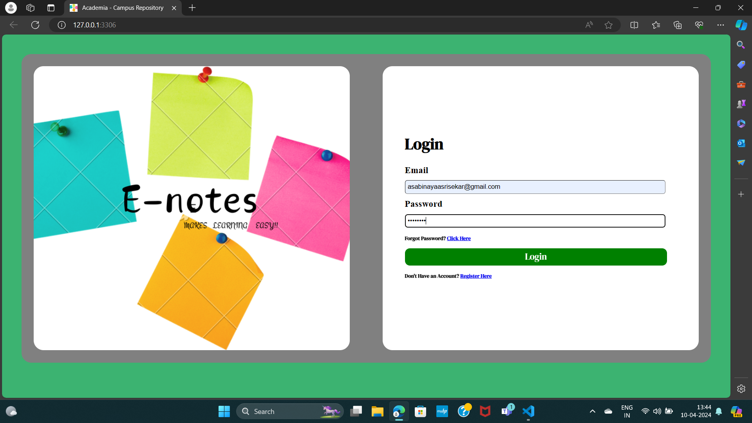
Homepage

Slide 10
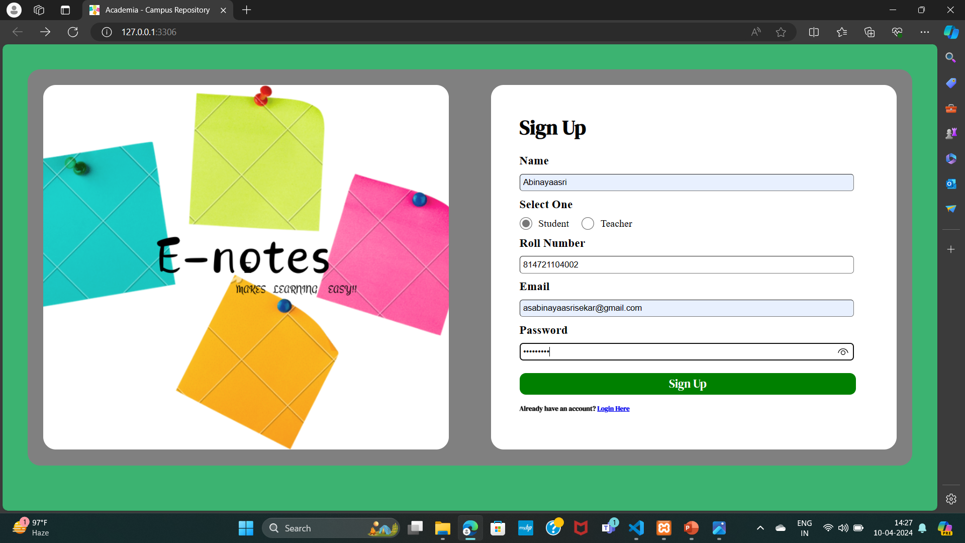
STUDENT’S LOGIN

Slide 11
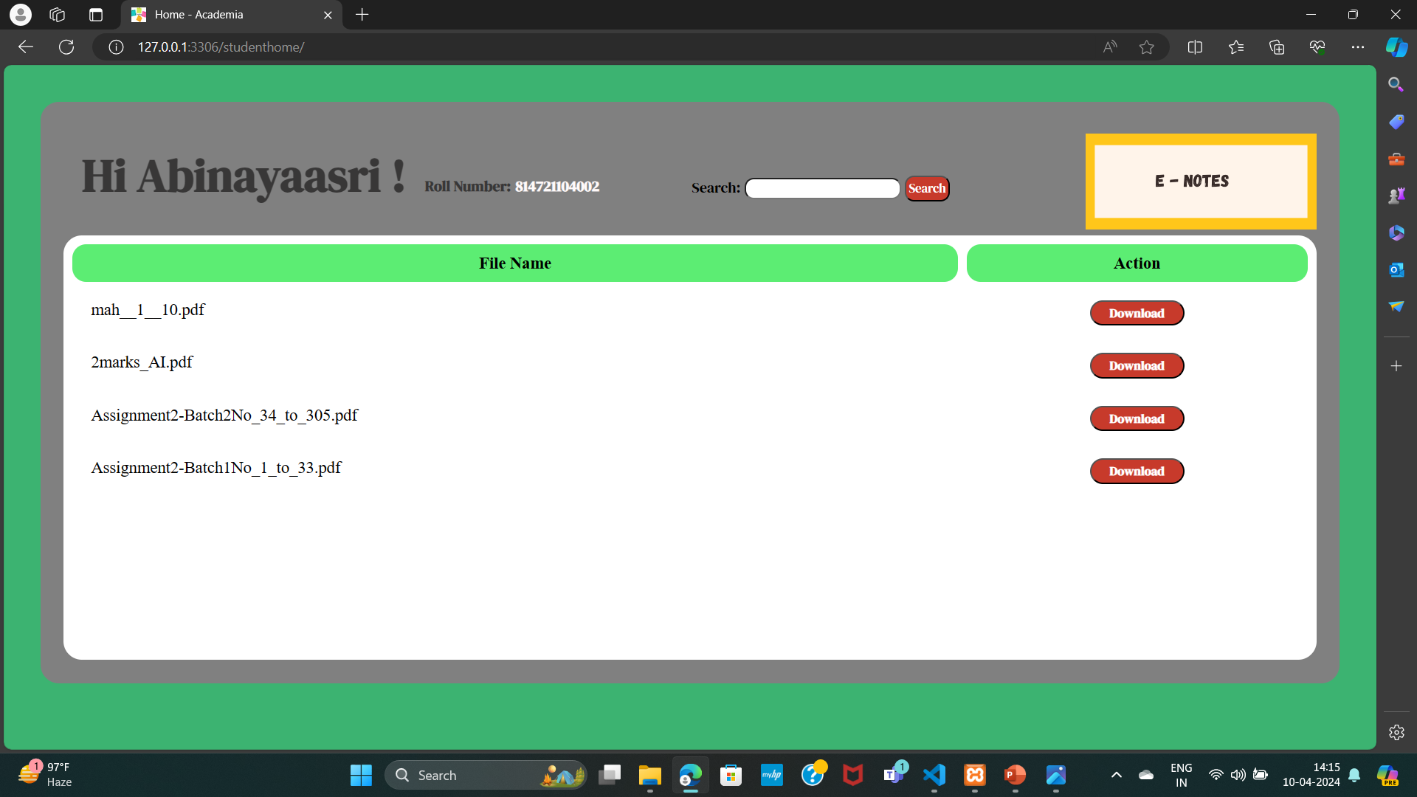
STUDENT’S PAGE

Slide 12

TEACHER’S LOGIN

Slide 13
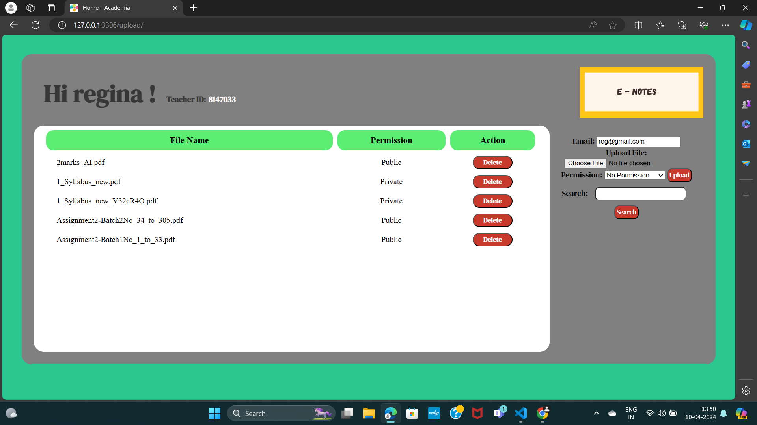
TEACHER’S PAGE

Slide 14
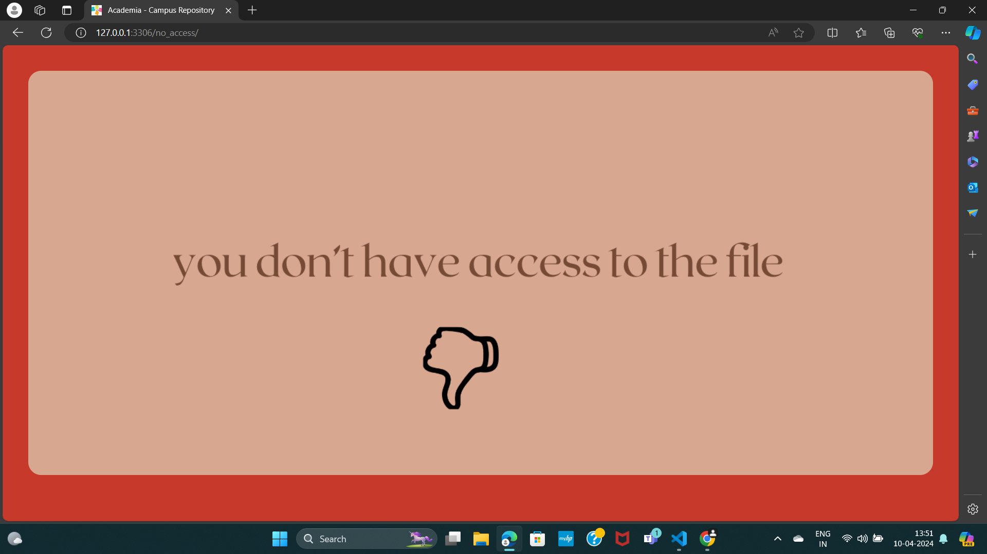
NO ACCESS

Slide 15
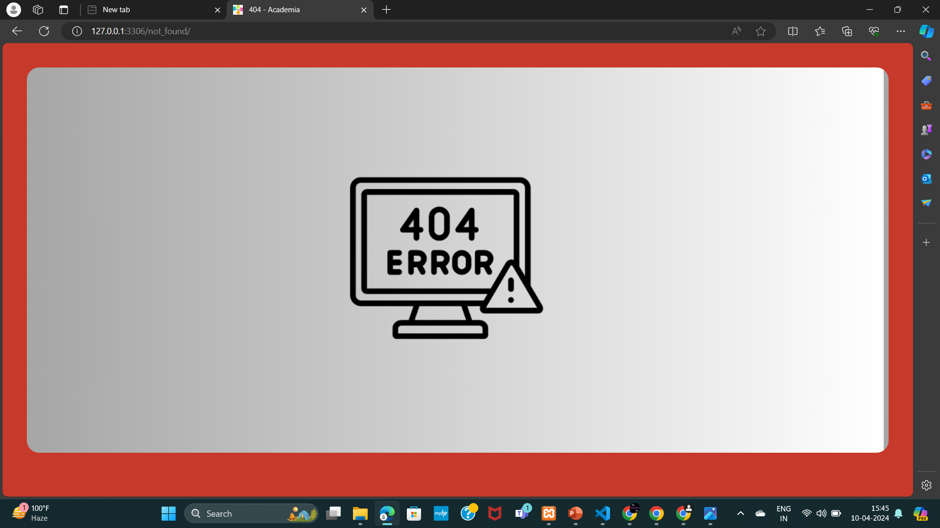
404 ERROR

Slide 16
Future Enhancements:
Real-Time Collaboration: Implement real-time editing and collaboration features, allowing multiple users to work on the same note simultaneously. This could include features like seeing other users' cursors in real-time, live chat, and version history tracking.
Rich Media Support: Enable users to embed images, videos, audio clips, and other multimedia content into their notes. This could enhance the richness and depth of the notes shared on the platform.
Advanced Search Functionality: Enhance the search functionality to allow users to search within their notes based on keywords, tags, dates, and other metadata. Implementing advanced search algorithms could improve the accuracy and speed of search results.
Customizable Templates: Provide users with a selection of customizable note templates tailored for different purposes such as meeting notes, project planning, to-do lists, etc. Allow users to create their own templates or customize existing ones to suit their specific needs

Slide 17
Conclusion
In conclusion, a notes sharing web application serves as a valuable tool for users to create, organize, and collaborate on notes efficiently. By fostering collaboration, enhancing productivity, and promoting knowledge sharing, such platforms play a crucial role in both personal and professional settings. As the demand for digital note-taking solutions continues to grow, it's imperative for developers to focus on innovation and user-centric design to stay competitive in the market.
Source :

Slide 18
Thank You!
Notes:
Thank You !!

